Slide 1

Beer Reviews
A Data Exploration and Analysis Project
Laura Hoffmann

Slide 2
The Questions
What factors go into beer reviews?
Which factors have the largest effect on the overall reviews?
The Hypothesis
I believe that taste will have the largest impact on the overall review.

Slide 3
The Data
Beer Reviews
Variables
Overall Review (Integer, 1-5)
Aroma Review (Integer, 1-5)
Appearance Review (Integer, 1-5)
Palate Review (Integer, 1-5)
Taste Review (Integer, 1-5)
ABV (Float, Percentage 0-100)
Beer Style (String, Categorical)

Slide 4
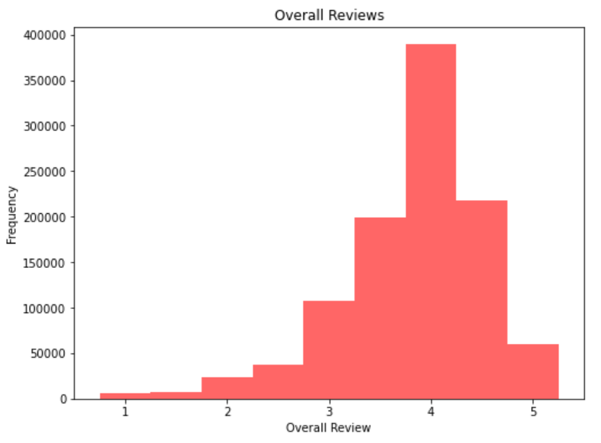
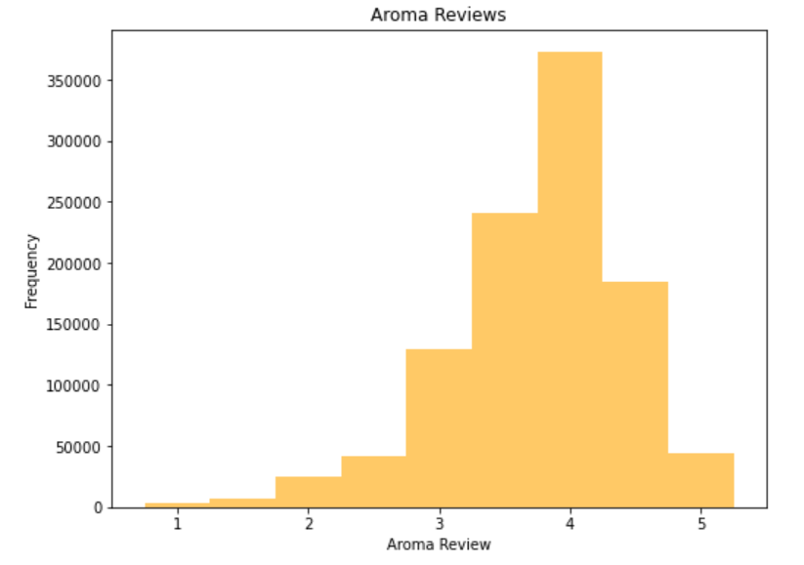
The Histograms
Data is skewed left

Slide 5
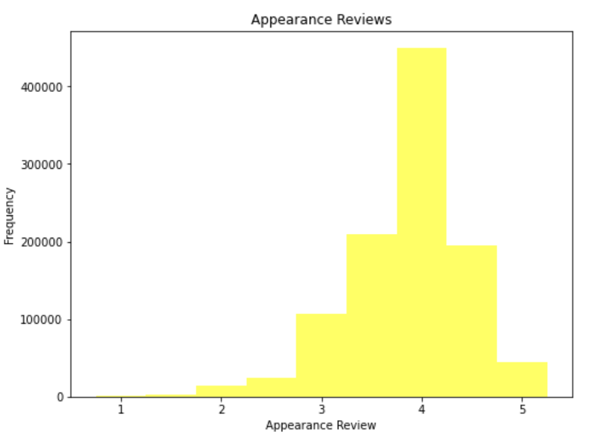
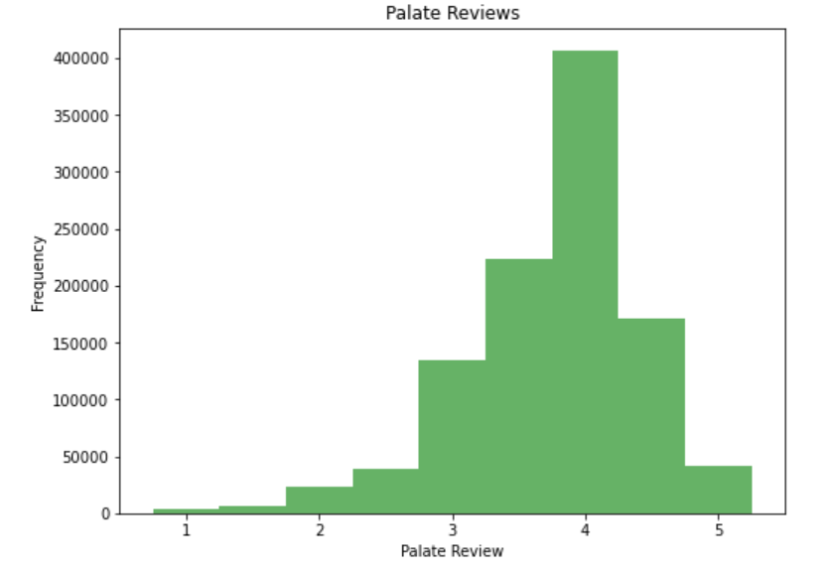
Data is skewed left

Slide 6
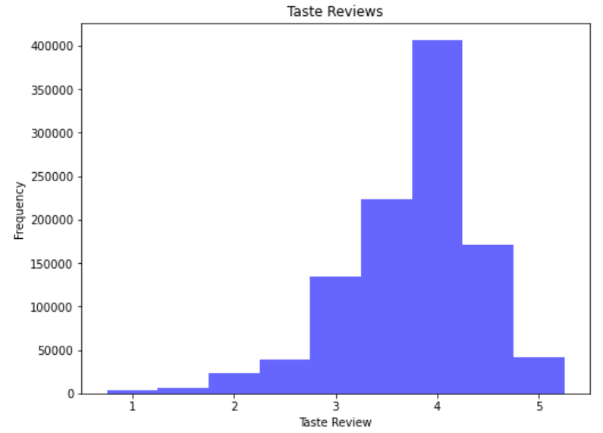
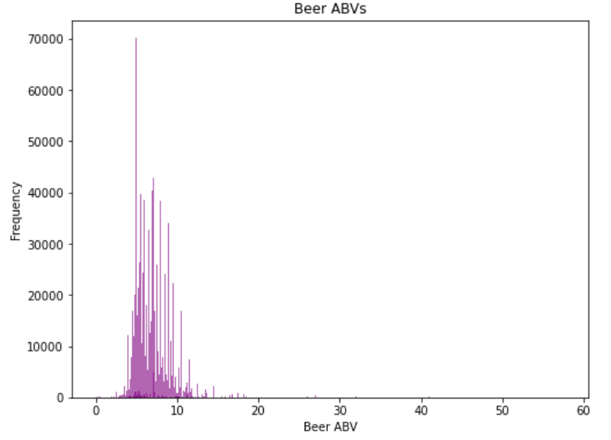
Data is skewed left
Data is skewed right
A few outliers exist over 40% but they are accurate values, so I kept them in the data

Slide 7
Statistics
Overall
Mean: 3.83
Mode: 4.0
Spread: 0.5
Aroma
Mean: 3.76
Mode: 4.0
Spread: 0.46
Appearance
Mean: 3.86
Mode: 4.0
Spread: 0.36
Palate
Mean: 3.76
Mode: 4.0
Spread: 0.44
Taste
Mean: 3.76
Mode: 4.0
Spread: 0.44
ABV
Mean: 7.07
Mode: 5.0
Spread: 5.15

Slide 8

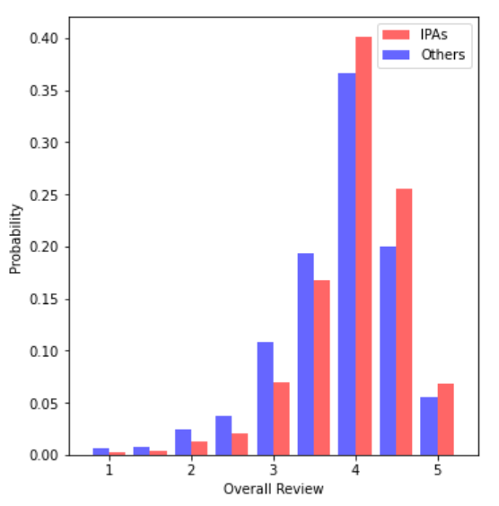
IPAs vs Non-IPAs
IPAs typically score higher than non-IPAs and non-IPAs are more likely to score lower.

Slide 9
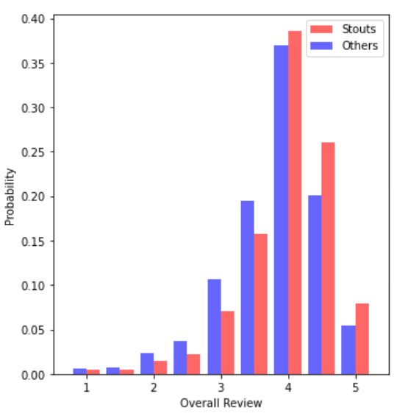
Stouts vs. Non-Stouts
Stouts typically score higher than non-stouts and non-stouts are more likely to score lower.

Slide 10
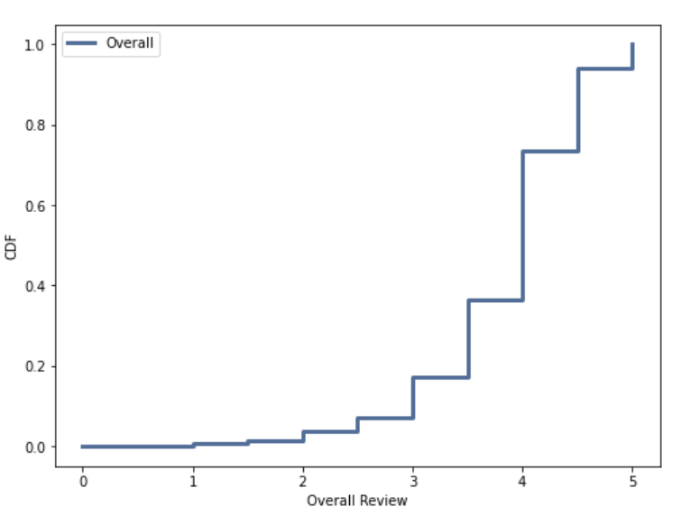
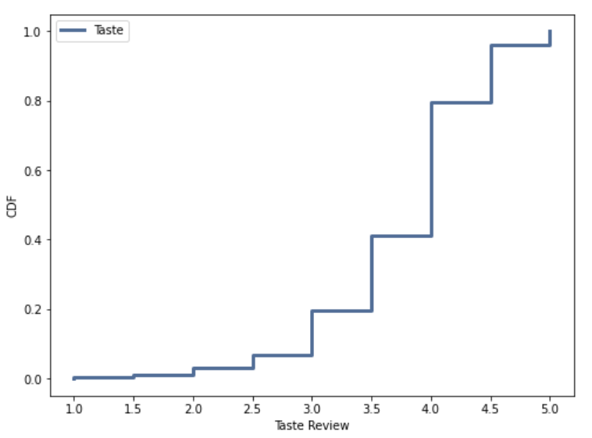
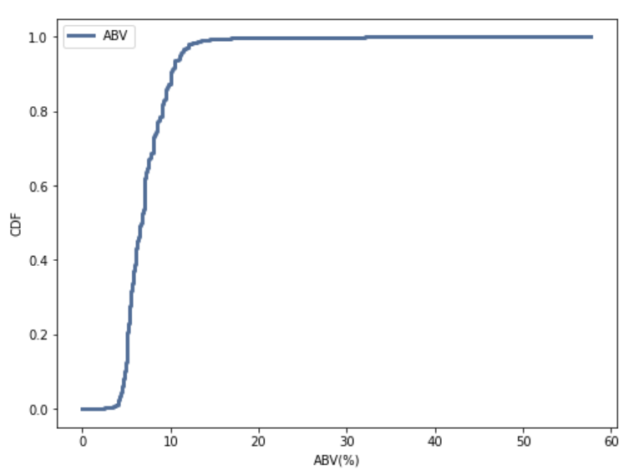
CDFs
Overall: 4.5 rating is about at the 90th percentile
Taste: 4.5 rating is about the 95th percentile
ABV: 10% is at the 80th percentile, 20% ABV is at the 99th percentile

Slide 11
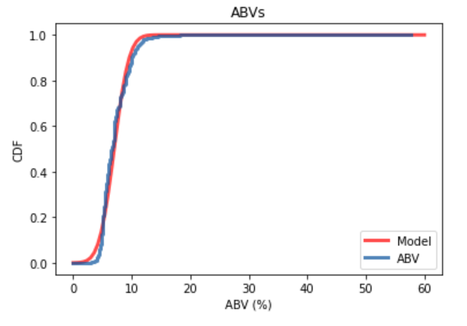
Analytical Distribution
Normal distribution, CDF of ABVs
Follows the normal curve relatively closely, except small discrepancies around 5% ABV and 10% ABV where there are less entries with those values than expected.

Slide 12
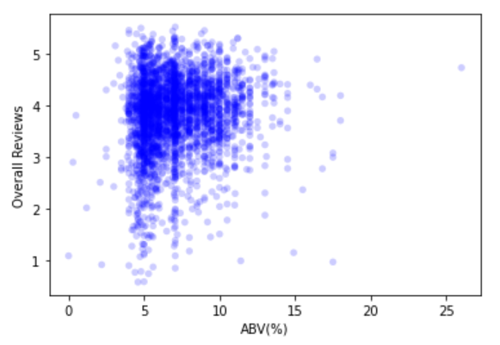
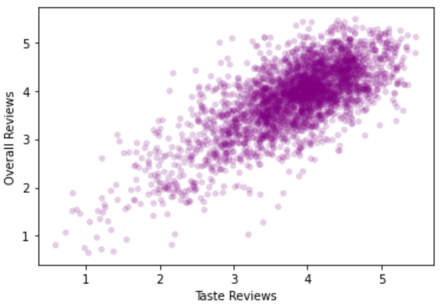
Scatter Plots
Highly positive relationship between Taste and Overall Reviews
Very little correlation between ABV and Overall Reviews

Slide 13
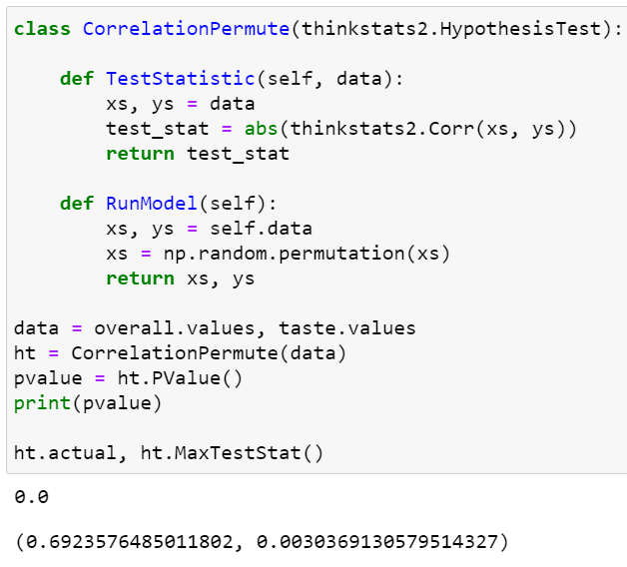
Hypothesis Test (Testing a Correlation)
The actual correlation is around .7
Taste review and overall review are closely correlated
The p-value is 0
After 1000 iterations the maximum simulated correlation is .003

Slide 14
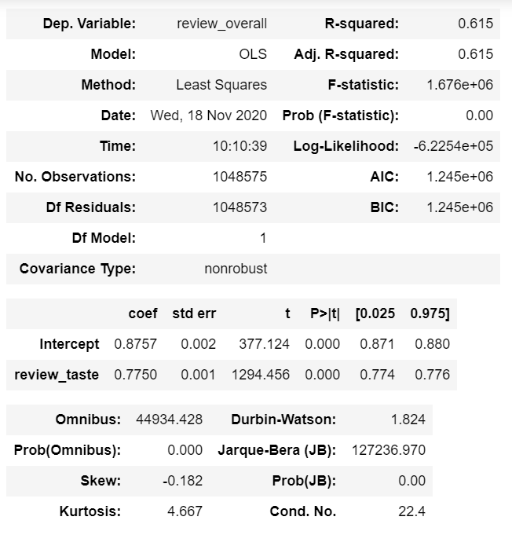
Regression Analysis
Overall Review ~ Taste Review

Slide 15
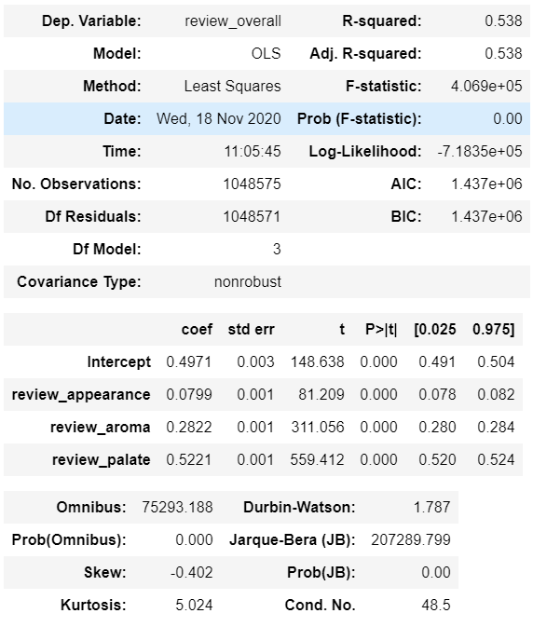
Regression Analysis
Overall Review ~ Appearance Review + Aroma Review + Palate Review

Slide 16
Regression Analysis
R-Squared is a lot higher for taste on the regression analysis than appearance, aroma and palate combined
Adjusted R-squared matches R-squared in both results
The coefficient is highest for taste

